Slide 1
Software Design Document
Hostel Management system

Slide 2
01
Introduction

Slide 3
1.1 Purpose
A comprehensive guide for the development team and stakeholders.
Ensures a clear understanding of system components and functionalities.
Ensures all parties involved understand the system's intended construction.
Guides development, ensuring alignment with requirements.

Slide 4
1.2 Scope
Hostel Management System focuses on streamlining hostel operations. Addresses core areas:
Room Allocation
Student Management
Staff Management
Incident Reporting
Feedback and Menu Management.

Slide 5
Project goals
Improving Operational Efficiency: Reducing manual workload through automation.
Enhancing User Experience: Providing an intuitive interface for all users.
Ensuring Data Accuracy and Security: Protecting sensitive data and maintaining accurate records.

Slide 6
1.3 Overview and Reference Material
Organized into sections detailing system overview, architecture, data design,
component design, human interface design, requirements matrix, and
appendices. Sources:
Software Requirements Specification (SRS)
Document and System Analysis Document

Slide 7
02
Architecture Requirements

Slide 8
2.1 Overview of Key Objectives
The system aims to automate
room allocation,
student management,
staff management,
incident reporting,
feedback and menu management
to enhance operational efficiency, user experience, and data security.

Slide 9
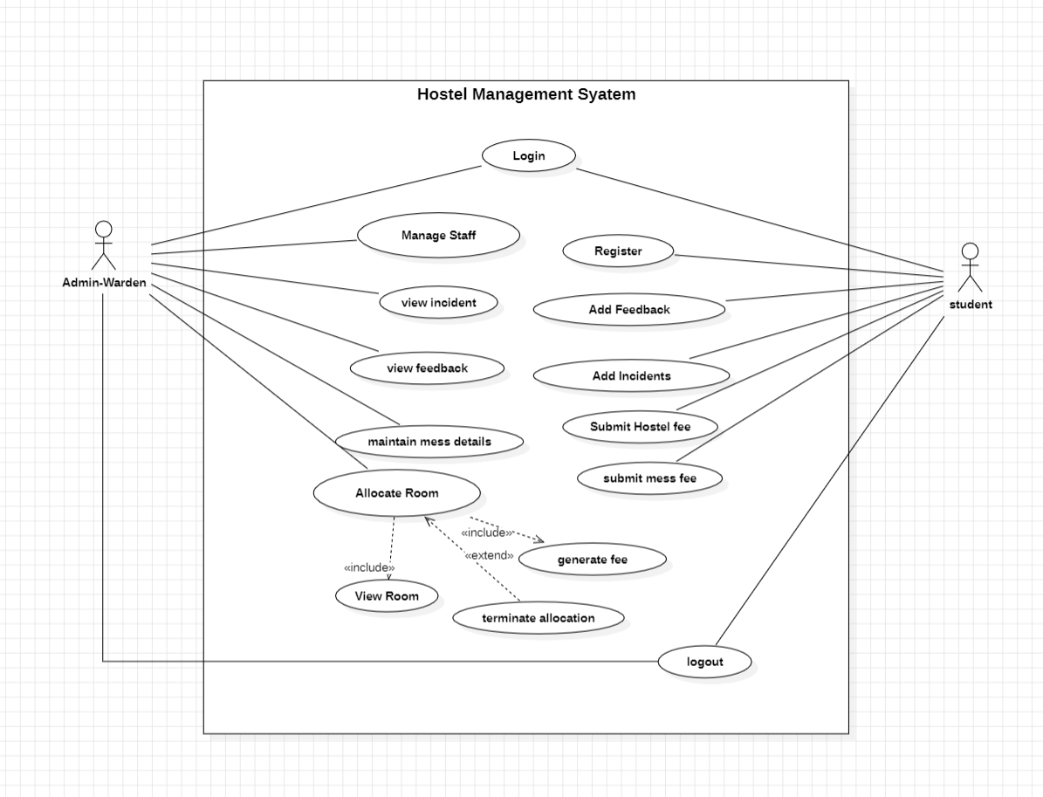
2.2 Architecture Use Cases
Room Allocation
Student Records
Staff Management
Incident Reporting
Feedback Management
Menu Management

Slide 10
2.3 Stakeholder Architectural Requirements
Staff
wardens
Administrators
Students

Slide 11
2.4 Constraints
Data Privacy
Budget Limitations
Availability of Resources
Legacy System Integration

Slide 12
2.6 Risks
Data Breaches
System Downtime
Scalability Issues
Functional Bugs
Compliance Failures

Slide 13
03
System Architecture
Microservices Architecture

Slide 14

Why Microservices Architecture?

Slide 15
1. Client Devices & API Layer
1. Client Devices
Our system supports multiple client devices, including web browsers, mobile apps, and other smart devices, allowing users to access the system anywhere.
2. API Layer
The API Layer serves as a gateway for all client requests, routing them to the appropriate microservices, ensuring security, and managing rate limits.

Slide 16
3. Microservices
Auth Service: Handles user authentication and authorization, managing user sessions and permissions.
Room Management Service: Manages room assignments, availability, and bookings, ensuring efficient allocation of resources.
Student Management Service: Maintains student profiles, registration details, and personal information.
Complaint Management Service: Allows students to file complaints and tracks their resolution status.
Reporting Service: Generates various reports on hostel operations, providing valuable insights.

Slide 17
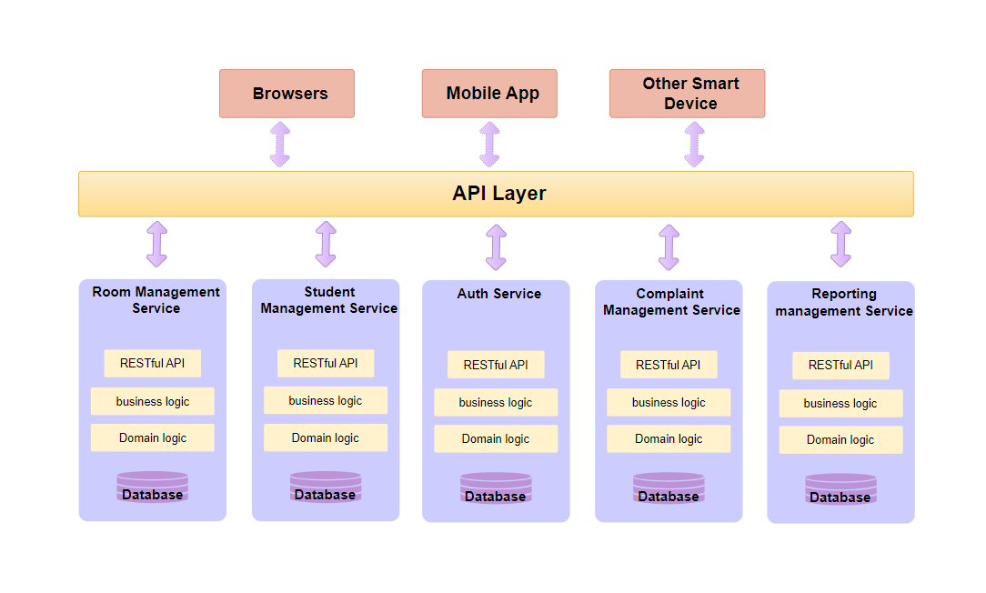

Slide 18
3.3 Structural Views

Slide 19
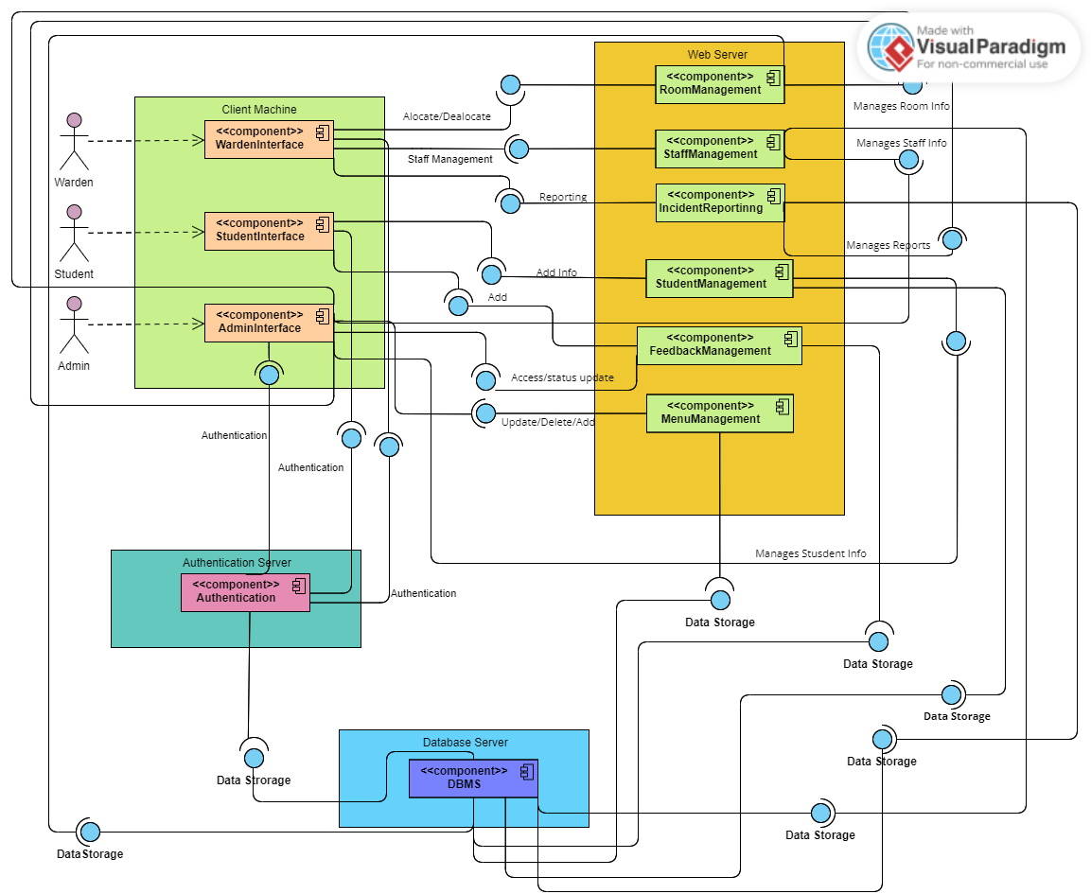
Component design

Slide 20
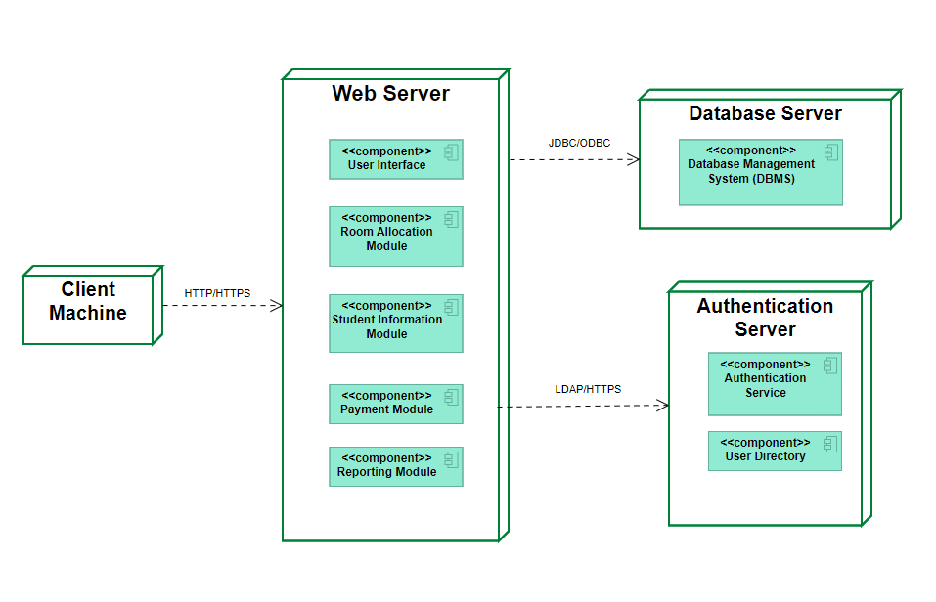
Deployment diagram

Slide 21
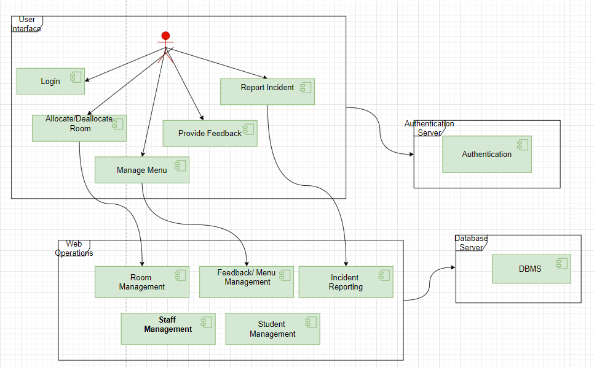
Composite Diagram

Slide 22
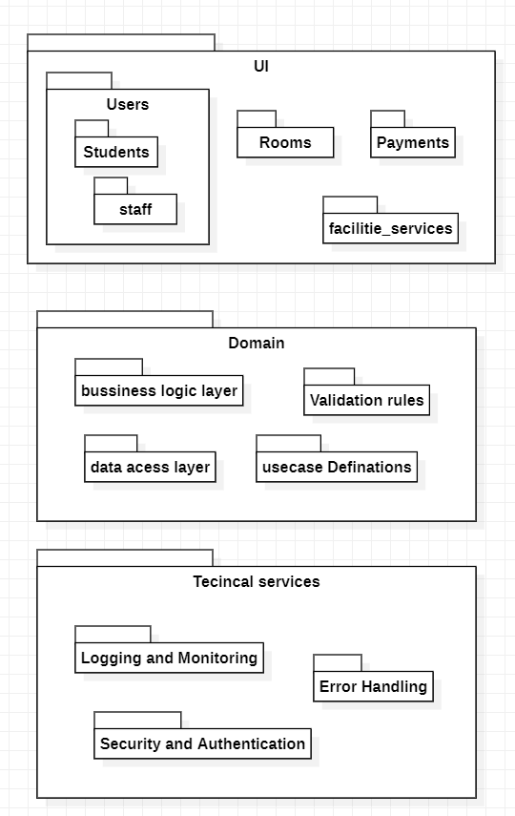
Package Diagram

Slide 23
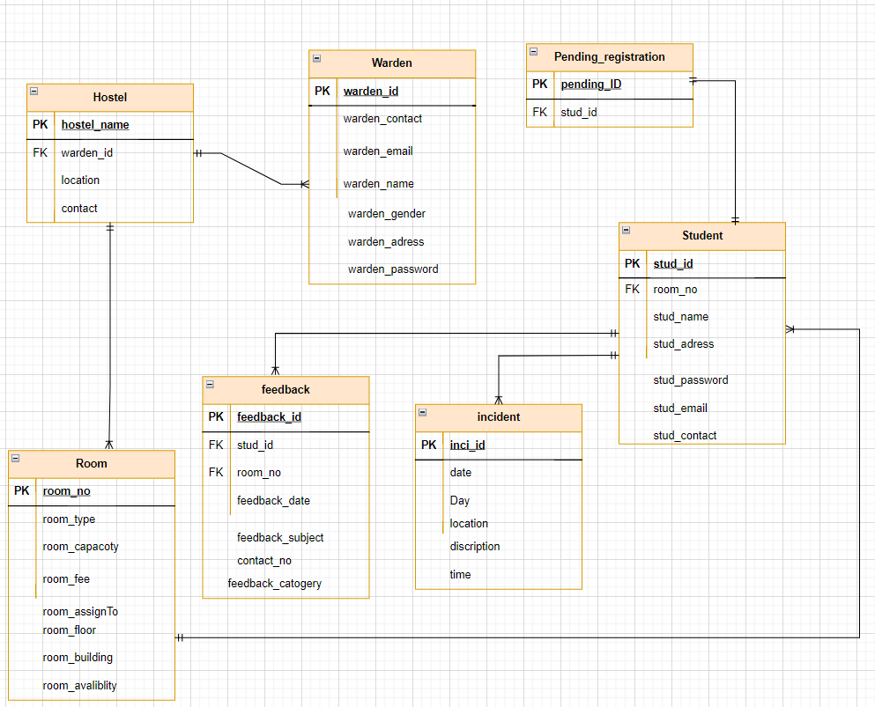
ER Diagram
Entities:
Users
Rooms
Students
Staff
Incidents
Feedback
Menus

Slide 24
3.3 Behavioral Views

Slide 25
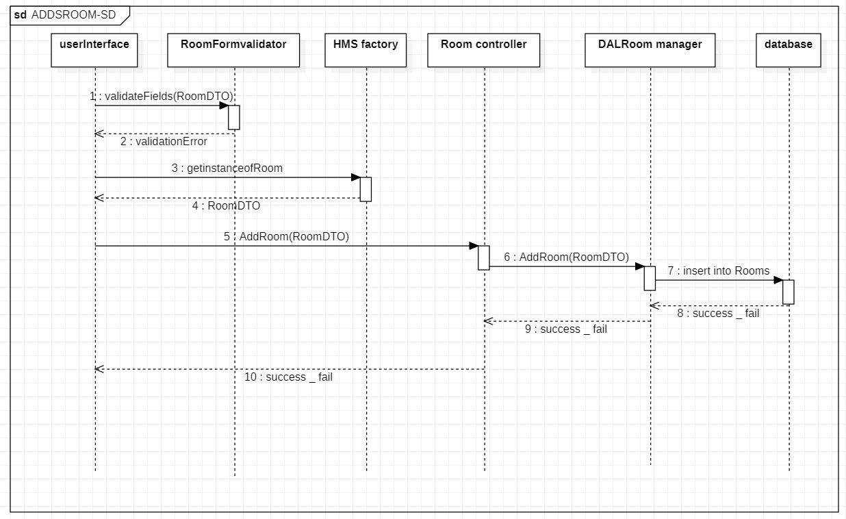
Sequence Diagram - Add Room

Slide 26

Sequence Diagram - Add Warden

Slide 27
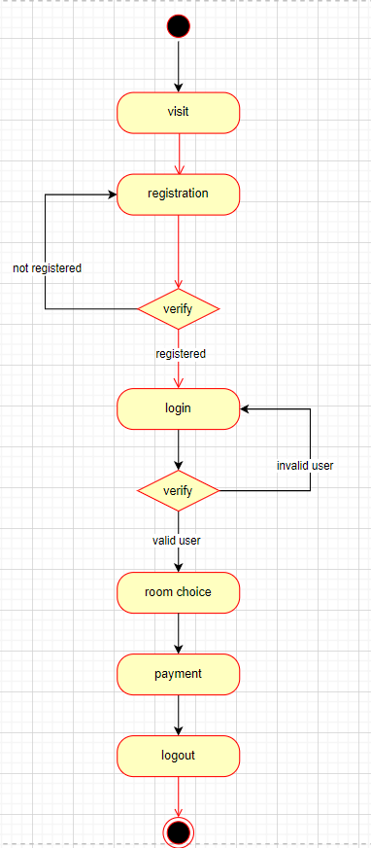
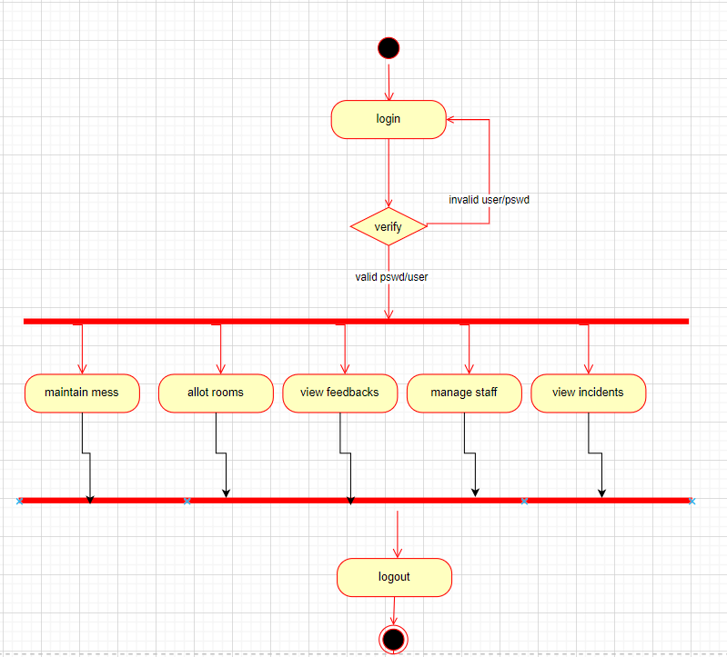
Figure 3 Activity diagram (for student)
Figure 4 Activity diagram for admin

Slide 28
04
Human interface Design

Slide 29
4.1 Overview of User Interface
The user interface provides intuitive navigation through different functionalities.

Slide 30
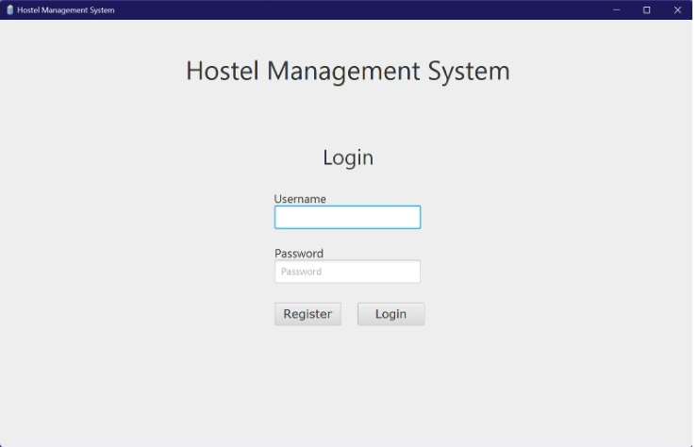
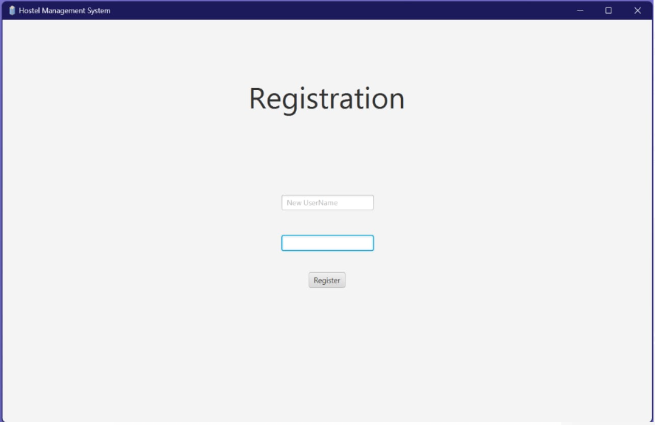
4.2 Screen Images

Slide 31
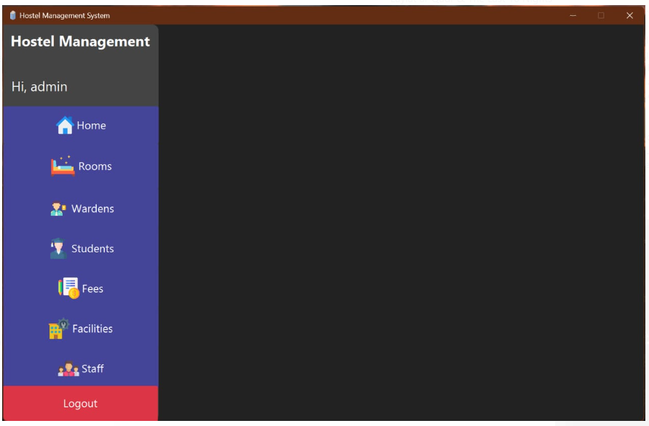
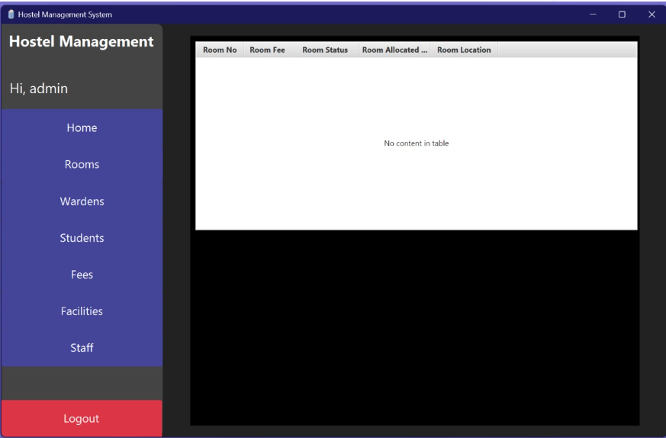

Slide 32
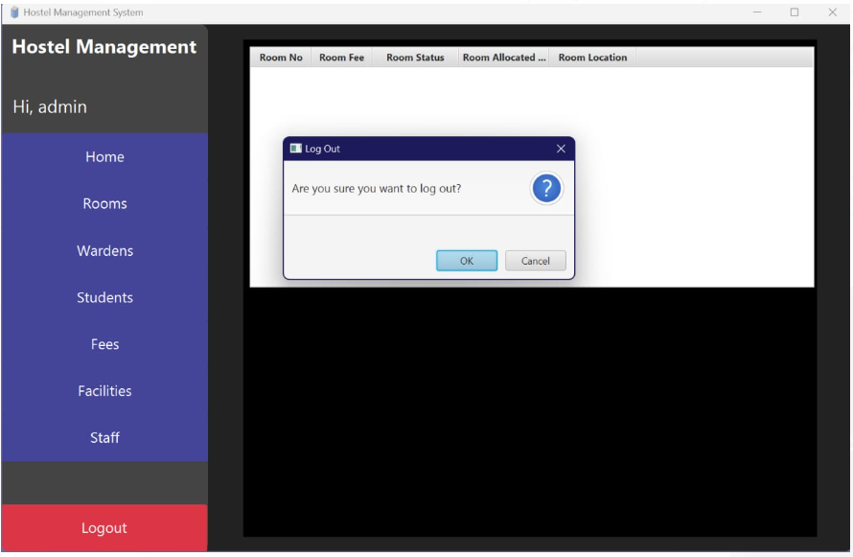

Slide 33
4.3 Screen Objects and Actions
Login Screen:
Objects: Username field, Password field, Login button
Actions: User enters credentials and clicks Login
Dashboard:
Objects: Navigation menu, Quick access buttons (e.g., Add Room, Add Student)
Actions: The user navigates to different functionalities using the menu

Slide 34
05
Appendices

Slide 35
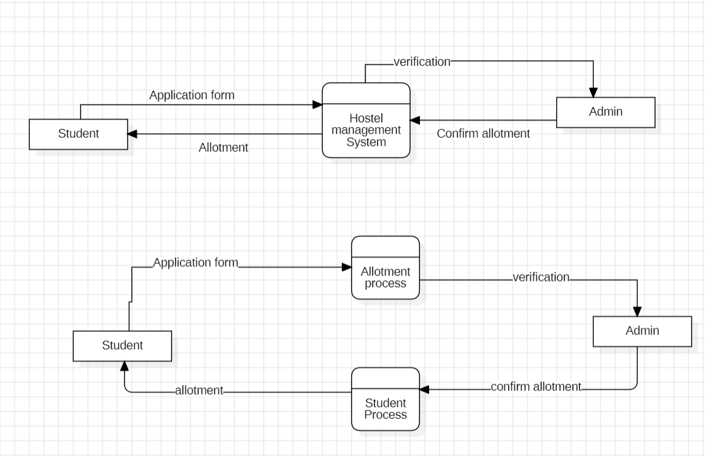
DFD level 0 & 1

Slide 36
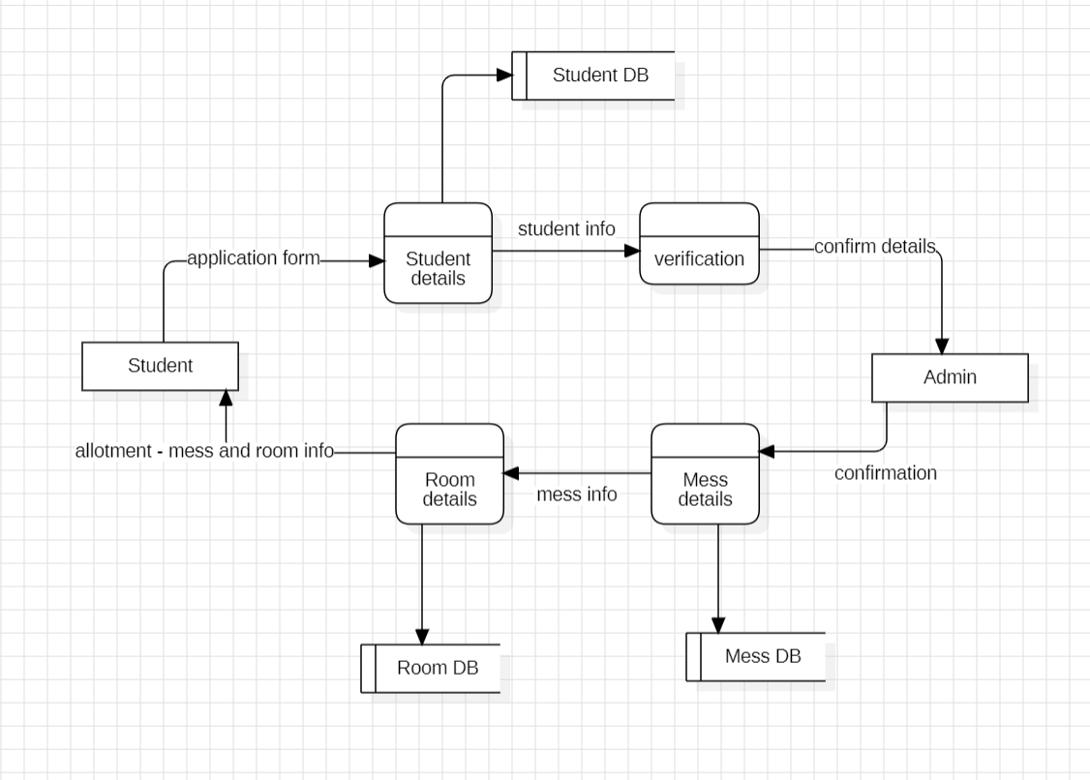
DFD level 2

Slide 37
Thanks!
Laiba Binte Tahir FA21-BSE-019
Arfah Ali FA21-BSE-080

